Slide 1
User Experience Design for Mobile solutions
Contents:
User Experience Site Map
Wireframe Screen Mock-Up
Wireframe Screen/Field Validations

Slide 2
UX design extract from a real-life mobile solution
Basis for producing UX designs:
UX requirements are derived from business requirements. The desired screen layout, look and feel is achieved by initially deriving the UX site map and then mocking up the screens and the associated screen/field validations as wireframes which would act as a blue print.
Person to Person payments (p2p) to elaborate UX design:
Enable me to share a bill with a friend for the lunch we had together
Scope of this document:
This document elaborates:
The complete site map for the above module,
Wireframe screen mock-up for selecting a friend from the list of all my contacts,
Screen/field validations of “Find a friend's contacts” screen.

Slide 3
UX Sitemap
Enable me to share a bill with a friend for the lunch we had together
Find a friend's contacts screen
Select the friend to pay screen
Enter friends phone no or name to have the list of all the relevant contacts displayed
Select a friend & Click “Enter”
Payment confirmation screen
Enter payment amount & Click “Send Money” button
Enter payment screen

Slide 4
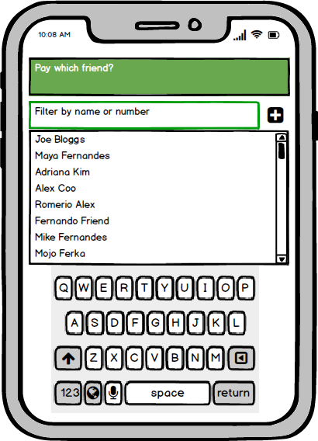
Wireframe Screen Mock Up Screen Name: Find a friend's contacts

Slide 5
Wireframe Screen/Field Validations Screen Name: Find a friend's contacts
Field Validations
Screen validations
Typing on the text box to find a friend's contacts automatically displays relevant contacts to chose from.
The key board box for typing automatically displays when I click on the text box to type a friends name or number.
If the total number of contacts is more than what the mobile screen can display, a scroll bar is displayed.
Selecting a friend from the list of all the contacts is mandatory before proceeding further to enter payment amount.
Field Name | Filter by name or number
Field Type | text box
Mandatory ? | Yes
Type of Characters | Alphanumeric
Field Length | N/A

